Slide 1
Review of digital logic design

Slide 2
Background
Logic gates (AND, OR, NOT, XOR, etc.)
Boolean algebra
Truth tables
Logic functions
Logic function synthesis by
Sum of Products (SOP)
Product of Sums (POS)
K-maps
Logic blocks (MUX, DEMUX)
Sequential elements (Latch, Flip-flop)

Slide 3
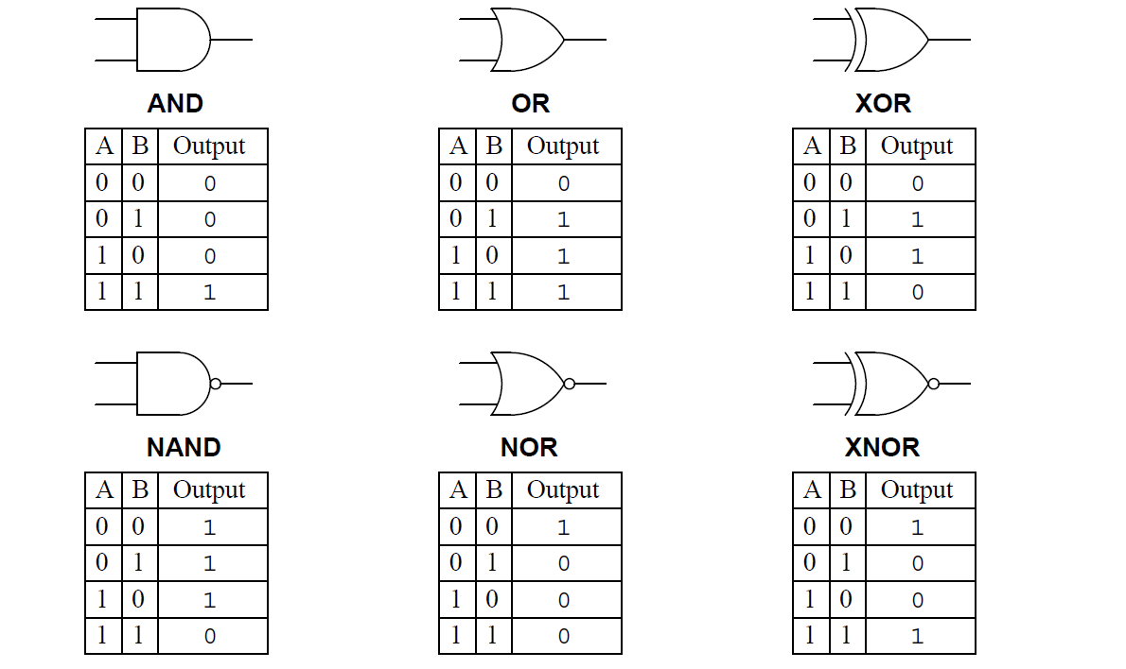
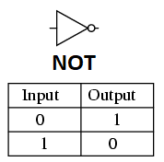
Logic gates

Slide 4
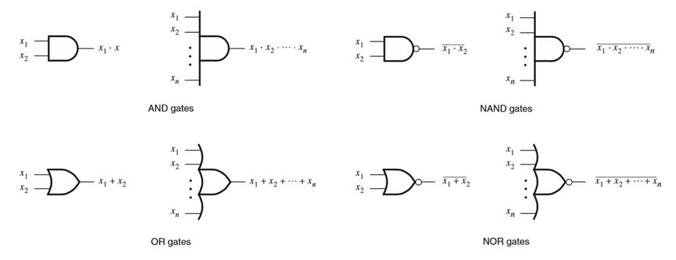
Generalized n-input logic gates

Slide 5
Axioms of Boolean Algebra
1a. 0 · 0 = 0
1b. 1 + 1 = 1
2a. 1 · 1 = 1
2b. 0 + 0 = 0
3a. 0 · 1 = 1 · 0 = 0
3b. 1 + 0 = 0 + 1 = 1
4a. If x = 0, then x’ = 1
4b. If x = 1, then x’ = 0

Slide 6
Boolean Algebra - Single Variable Theorems
5a. x · 0 = 0
5b. x + 1 = 1
6a. x · 1 = x
6b. x + 0 = x
7a. x · x = x
7b. x + x = x
8a. x · x’ = 0
8b. x + x’ = 1
9. (x’)’ = x

Slide 7
Boolean Algebra - Two Variable Properties
10a. x · y = y · x Commutative
10b. x + y = y + x
11a. x · ( y · z) = (x · y) · z Associative
11b. x + ( y + z) = (x + y) + z
12a. x · ( y + z) = x · y + x · z Distributive
12b. x + y · z = (x + y) · (x + z)
13a. x + x · y = x Absorption
13b. x · (x + y) = x
14a. x · y + x · y’ = x Combining
14b. (x + y) · (x + y’) = x

Slide 8
Boolean Algebra - Two & Three Variable Properties
15a. (x · y)’ = x’ + y’ DeMorgan’s theorem
15b. (x + y)’ = x’ · y’
16a. x + x’ · y = x + y
16b. x · (x + y) = x · y
17a. x · y + y · z + x’ · z = x · y + x’ · z Consensus
17b. (x + y) · (y + z) · (x’ + z) = (x + y) · (x’ + z)

Slide 9
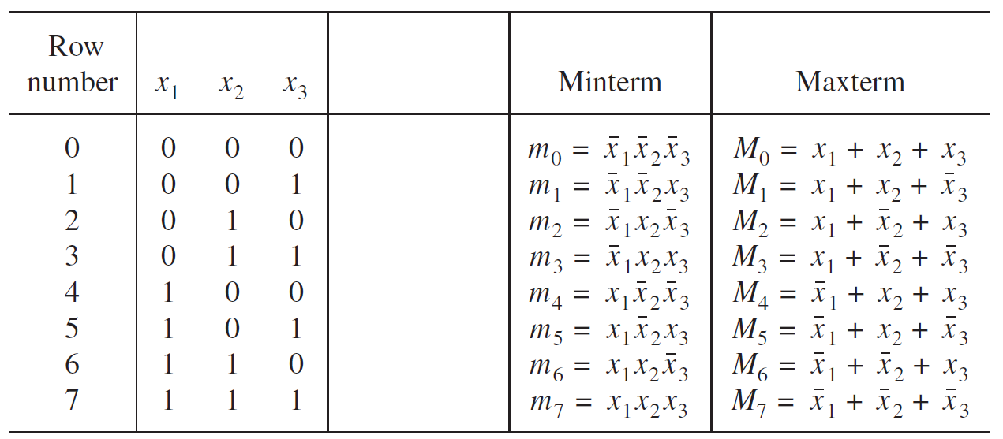
Logic Function Synthesis - Three variable SOP & POS
Function synthesis from truth table

Slide 10
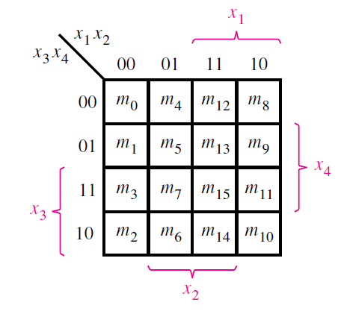
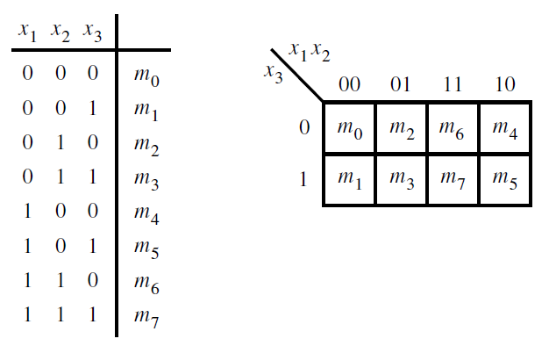
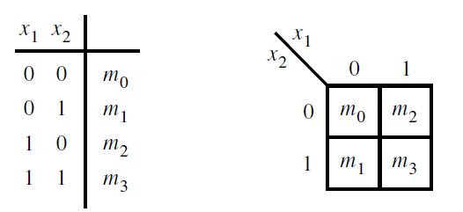
Logic Function Synthesis - 2/3/4 variable k-map
Function synthesis using k-maps

Slide 11
Logic Function Synthesis - 2/3/4 variable k-map
Function synthesis using k-maps
No zeros allowed.
No diagonals.
Only power of 2 number of cells in each group. (2⁰=1, 2¹=2, 2²=4, 2³=8, etc.)
Groups should be as large as possible.
Every 1 must be in at least one group.
Overlapping allowed.
Wrap around allowed.
Fewest number of groups possible.
Visit: http://www.ee.surrey.ac.uk/Projects/Labview/minimisation/karrules.html

Slide 12
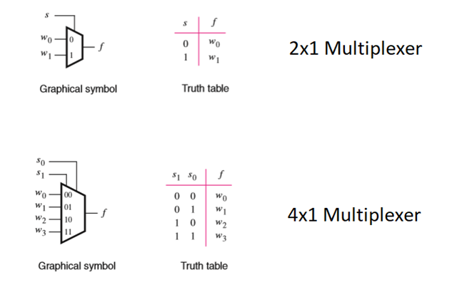
Multiplexer
Multiple inputs, single output. Output is chosen by selector pin/s

Slide 13
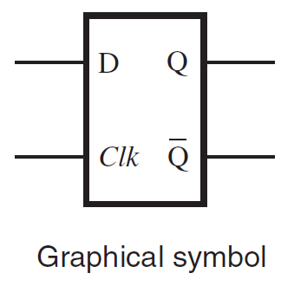
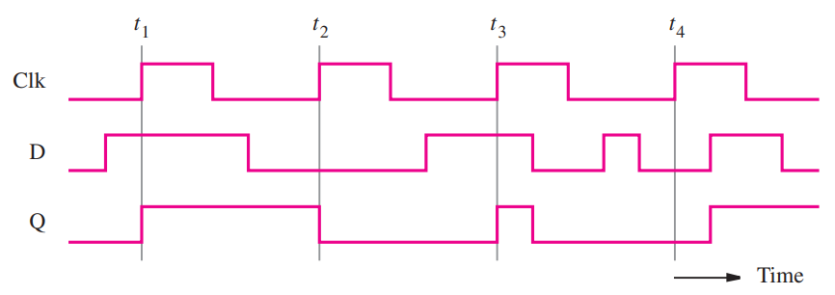
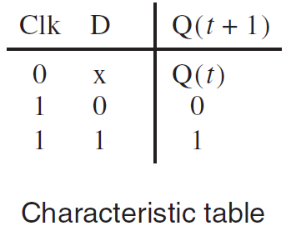
D Latch
Level sensitive element
A positive level triggered D latch
copies D to output Q, if Clock=1, else preserves the previous output
A negative level triggered D latch
copies D to output Q, if Clock=0, else preserves the previous output

Slide 14
D Latch
Level sensitive element
A positive level triggered D latch
copies D to output Q, if Clock=1, else preserves the previous output
A negative level triggered D latch
copies D to output Q, if Clock=0, else preserves the previous output

Slide 15
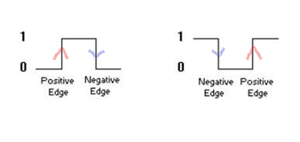
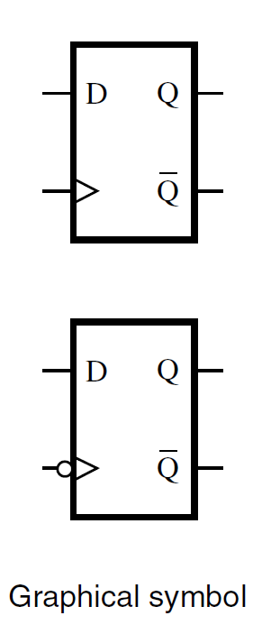
D Flip-flop
Edge sensitive element
A positive edge triggered D flip-flop
Sets Q=D at all positive edges (rising edges) of the clock, retains the old value of Q otherwise
A negative edge triggered D flip-flop
Sets Q=D at all negative edges (falling edges) of the clock, retains the old value of Q otherwise

Slide 16
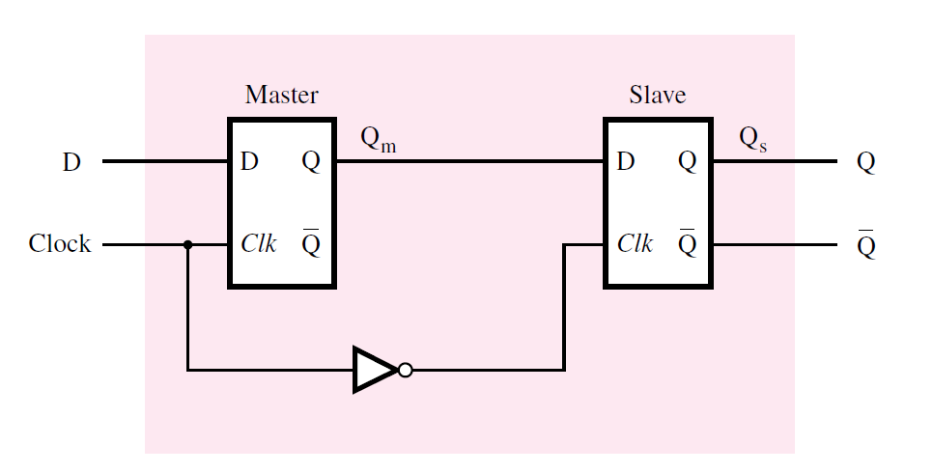
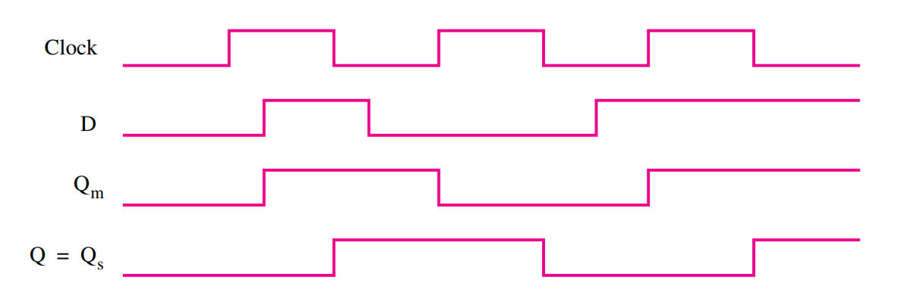
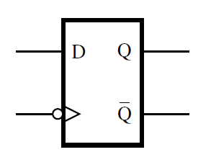
Building D Flip-flops using D Latches
By cascading a positive level triggered D latch and a negative level triggered D latch we can build a negative edge triggered D flip-flop

Slide 17


Building D Flip-flops using D Latches
By cascading a positive level triggered D latch and a negative level triggered D latch we can build a negative edge triggered D flip-flop
symbol of negative edge Flipflop
follow the Q_{m}, clock_bar signals to draw Q_{s} ie, Q of the second latch

Slide 18
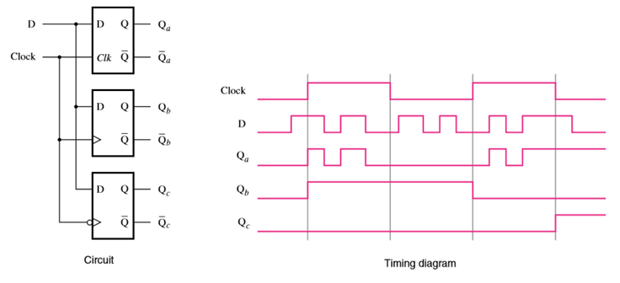
Level triggered vs. Edge triggered
In level triggered elements
output is affected by the clock levels (high/low)
In edge triggered elements
output is affected by the clock edges (positive edge/negative edge) (rising edge/falling edge)

Slide 19


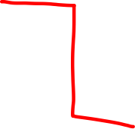













Slide 20























